Slide 1

An Analysis of Windows DPAPI
Contributors:
Special Thanks:
Notes:
By the end of this presentation you will understand how you can take the DPAPI files and then decrypt your own chrome browser password
Why do you need to know DPAPI?
Used everyday by us unknowingly when we login to our windows computer
Other applications that use DPAPI: chrome edge opera brave vmware dropbox skype and windows hello
What is DPAPI?
it stands for data protection application programming interface
it is a pair of function calls that provide operating system-level data protection services to user and system processes
So what we know about DPAPI is that there is this two function calls cryptprotectdata and cryptunprotectdata
but what it encrypts can be anything like a password database which uses the windows user account
Stands for secure hashing algorithm 1
One way operation
sha1 with secret key
PBKDF2 is deliberately slow to compute
Slowness can be controlled by adjusting the number iterations
Password
DPAPI context, hash from SHA 1
Salt - a sequence of bits that is assigned to different passwords so that identical passwords won’t map to the same hash.
Key - session key
IV - prepend a bit of random content to each message
Modes - CBC

Slide 2
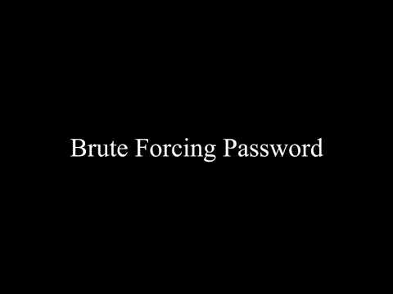

Slide 3
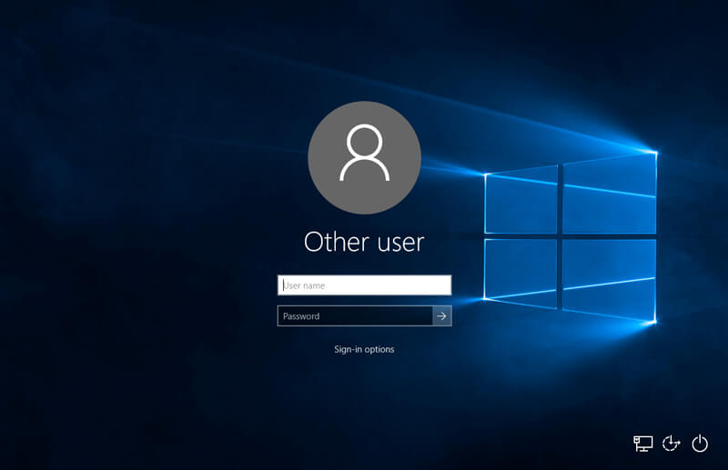
Need research more

Slide 4









Slide 5
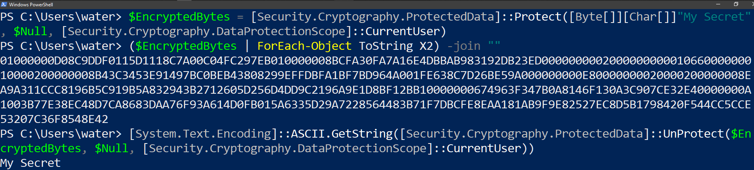
Data Protection Application Programming Interface

Slide 6
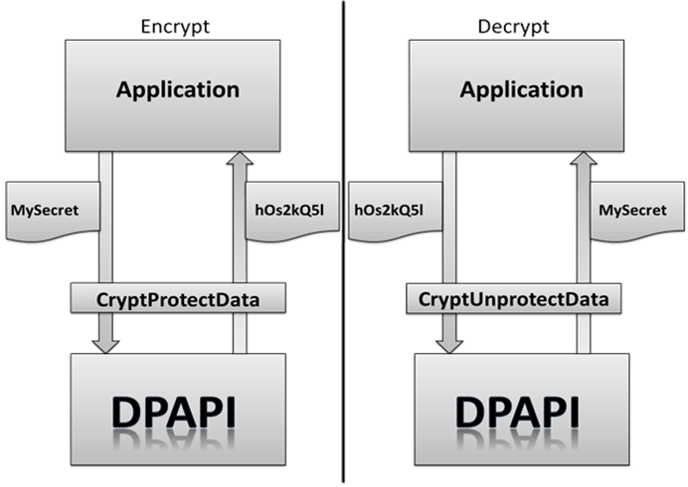

Slide 7
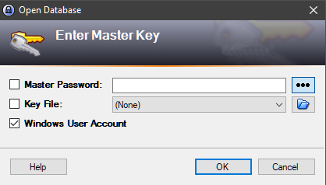
CryptProtectMemory:
A function to encrypt memory
that contains password

Slide 8
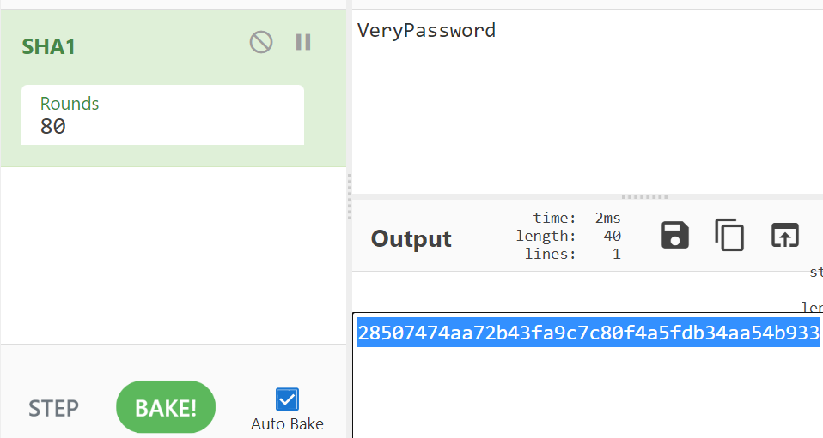
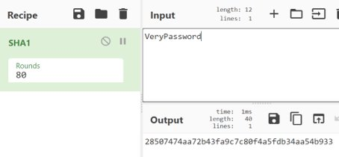
SHA 1
The higher the number of rounds, the more resistant it is against cryptanalytic attacks

Slide 9
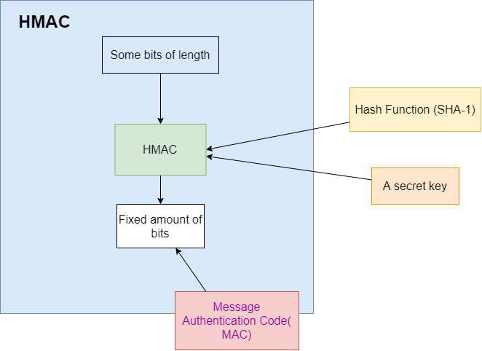
HMAC- SHA1

Slide 10
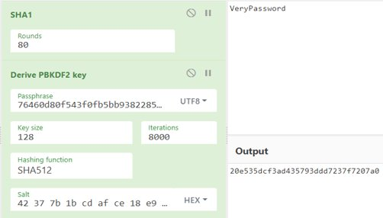
PBKDF2
Notes:
https://crypto.stackexchange.com/questions/35275/whats-the-difference-between-pbkdf-and-sha-and-why-use-them-together The password hash is then used for the PBKDF2 function to
PBKDF2 - YouTube
Describe it generally because of the way windows has it's own PBKFDF2 unless u understand the python code then go ahead xD I struggling to understand wtf it's doing
It uses 8000 iterations ,however previous Windows OS may use different iterations
sixteen random bytes for a salt
Uses hash generated from SHA 2
Requires 3 fields iterations , salt and dklen

Slide 11
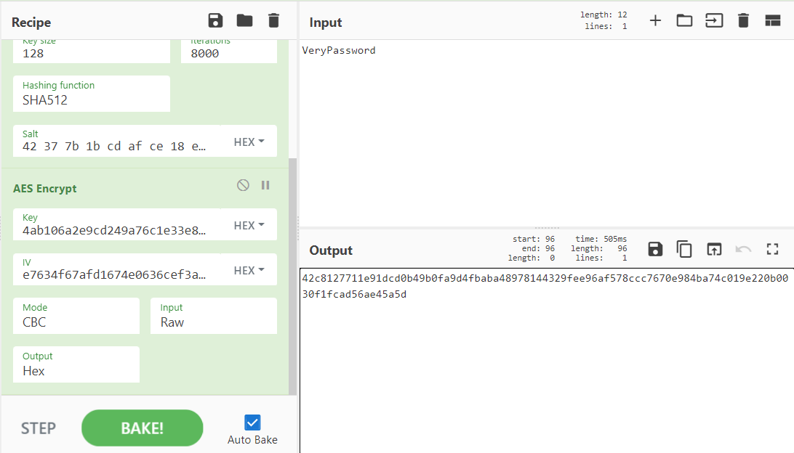
AES 256

Slide 12
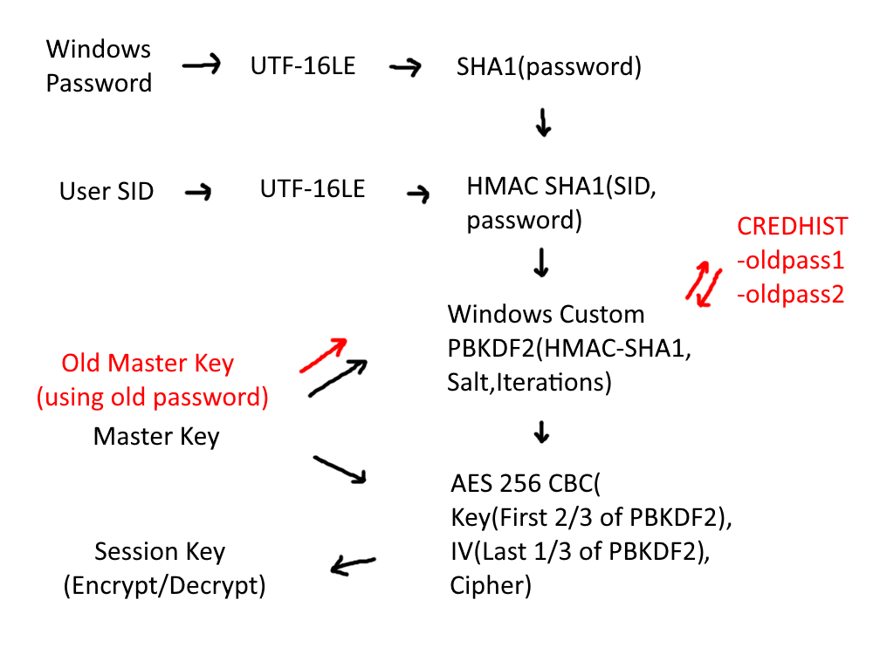

Slide 13
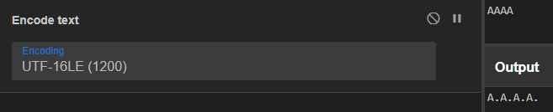
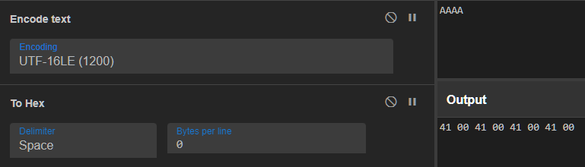
UTF-16LE
LE-Little Endian

Slide 15
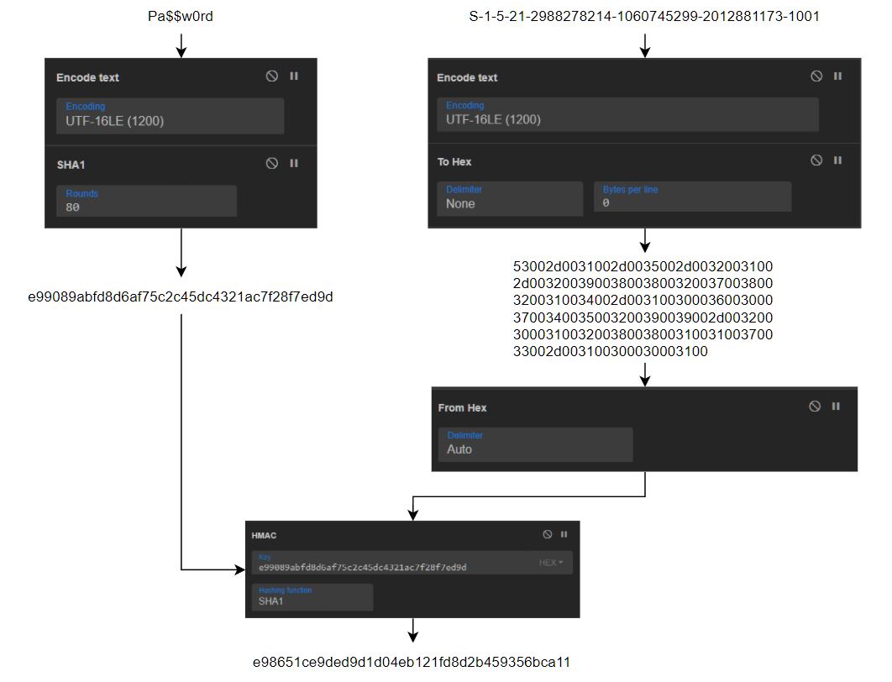
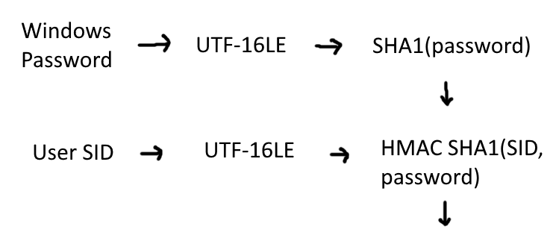

Slide 17
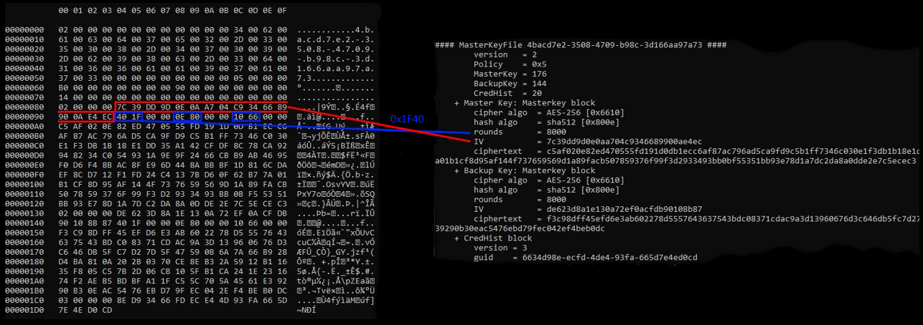
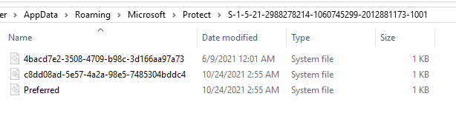
Master Key

Slide 19
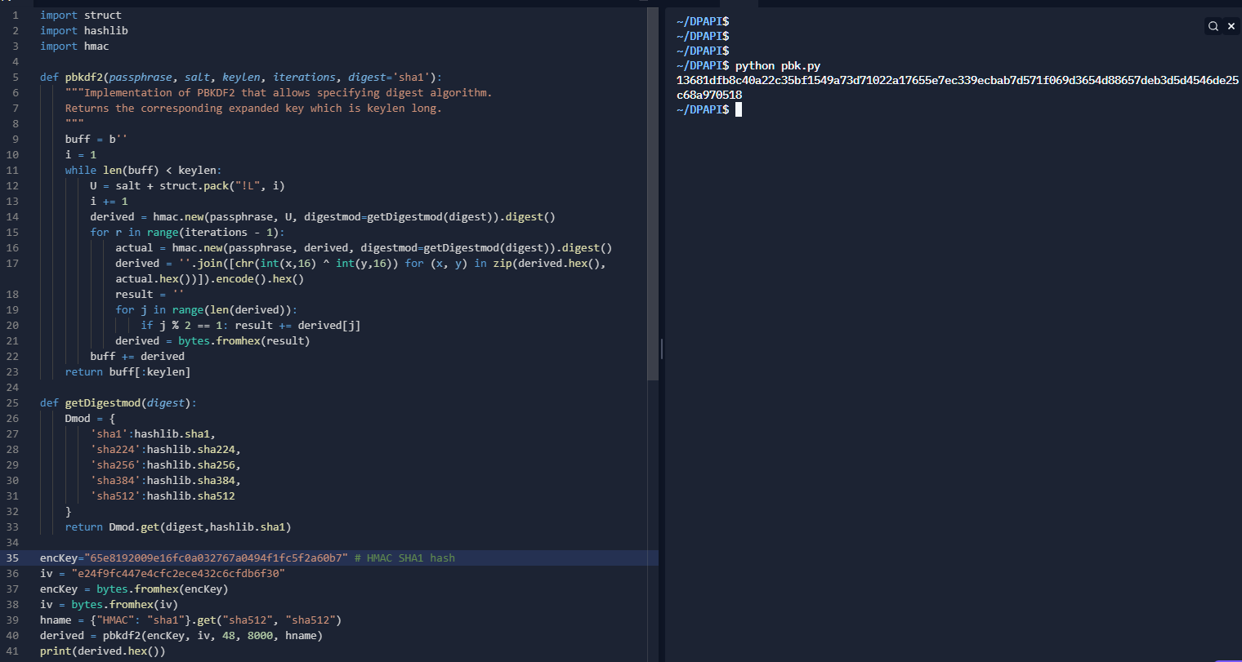
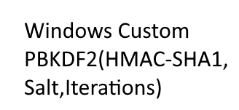
Custom PBKDF2

Slide 21
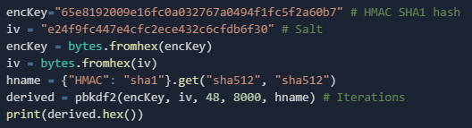
Custom PBKDF2

Slide 23
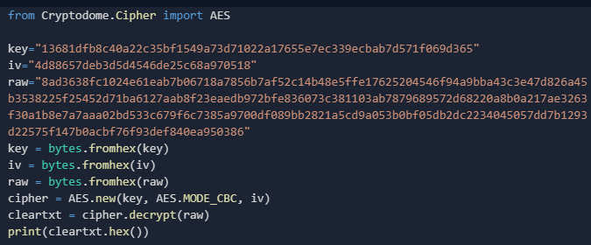

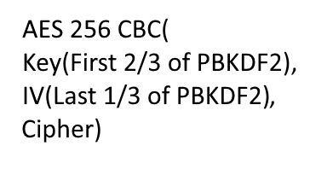
AES Decryption

Slide 25
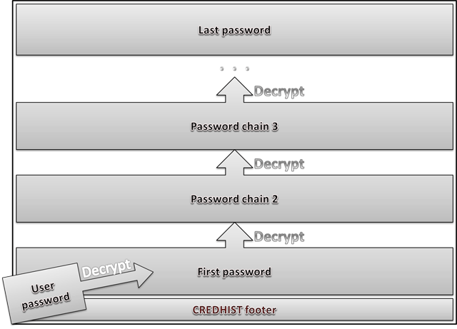
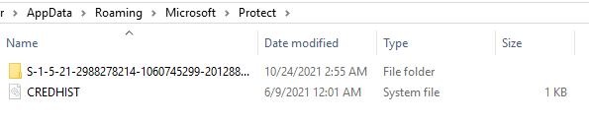
CREDHIST

Slide 27
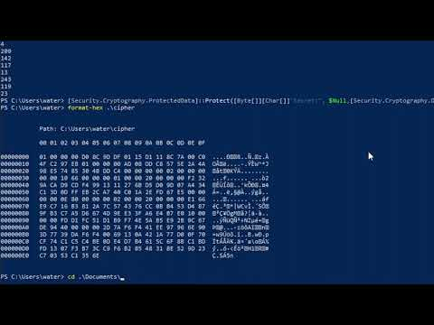

Slide 28
Contributions
Shown examples of DPAPI being used
Demonstrate how easy it is to used DPAPI
Demonstrating how the session key was decrypted to then decrypt the chrome browser password

Slide 29
References
https://docs.microsoft.com/en-us/dotnet/standard/security/how-to-use-data-protection
https://www.insecurity.be/blog/2020/12/24/dpapi-in-depth-with-tooling-standalone-dpapi/
https://jarnobaselier.nl/crack-dpapi-met-cqure-cqtools/
https://book.hacktricks.xyz/windows/windows-local-privilege-escalation/dpapi-extracting-passwords#encrypting-and-decrypting-content
https://www.ired.team/offensive-security/credential-access-and-credential-dumping/reading-dpapi-encrypted-secrets-with-mimikatz-and-c++#using-dpapis-to-encrypt-decrypt-data-in-c
https://study.com/academy/lesson/des-vs-triple-des-encryption.html
https://www.synacktiv.com/ressources/univershell_2017_dpapi.pdf
https://z3r0th.medium.com/abusing-dpapi-40b76d3ff5eb
https://docs.microsoft.com/en-us/previous-versions/ms995355(v=msdn.10)?redirectedfrom=MSDN#windataprotection-dpapi_topic04
https://threathunterplaybook.com/library/windows/data_protection_api.html#master-key
https://drive.google.com/file/d/0B9MkvtnWPqvEMmI2NWU1YTUtZDIyMC00Mjk3LWEyZGUtOGM2YzA3NzUzMTk2/view?hl=fr&pli=1&resourcekey=0-VTdErgyHRaU6JbQL-OwFoQ
https://www.passcape.com/index.php?section=docsys&cmd=details&id=28
https://www.secpod.com/blog/cve-2015-2808-bar-mitzvah-attack-in-rc4-2/
https://www.cryptomathic.com/news-events/blog/3des-is-officially-being-retired
https://cheapsslsecurity.com/p/sha1-vs-sha2-the-technical-difference-explained-by-ssl-experts/#:~:text=The%20basic%20difference%20between%20SHA1,a%20much%20more%20secure%20algorithm.&text=However%2C%20you'll%20see%20in,may%20still%20use%20SHA%2D1.

Slide 30
All Non-Proprietary Used
https://en.wikipedia.org/wiki/File:Windows_logo_-_2012.svg
https://i.kym-cdn.com/photos/images/original/001/234/929/6c9.png
https://imgflip.com/memegenerator/10013392/Happy-Squirrel

